Slide 1
Family Accounting
Aquarius v1.0
Notes:
Application Script:
---------------------------------------------------------------------------------------------
-- Initial
1. T-shirts: <date>13<date><amount>99</amount> <outgoing account>credit card</outgoing account> <cost>Clothing</cost> <area>Daily Life</area>
2. Dinner at ABC restaurant: <date>13<date><amount>149</amount> <outgoing account>credit card</outgoing account> <cost>Dinner</cost> <area>Entertainment</area>
3. Traffic on work: <date>13<date><amount>10</amount> <outgoing account>Traffic card</outgoing account> <cost>Traffic</cost> <area>Work</area>
4. Vendor master data: ABC restaurant
5. Customer master data: DEF company
----------------------------------------------------------------------------------------------------

Slide 2
Outlines
Daily record entry
Reports
Family-Accounting Settings
Advanced functionality

Slide 3
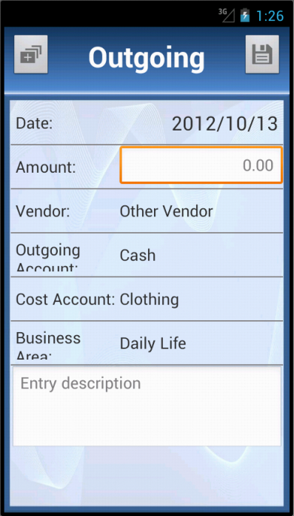
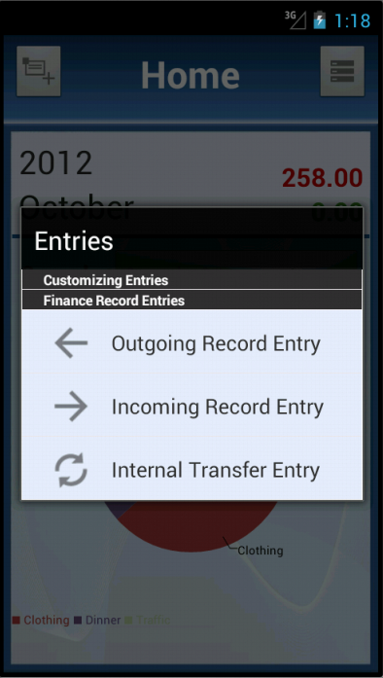
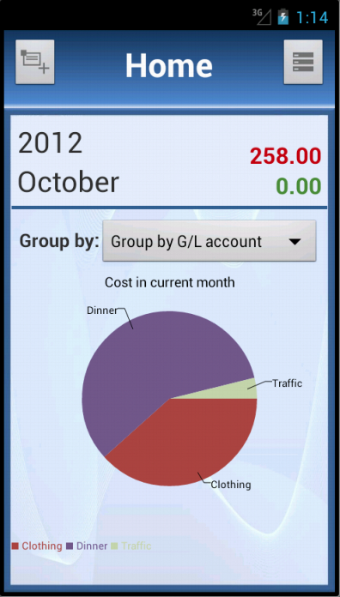
Open Basic record entry

Slide 4
Outgoing Entry
Date: date when financial event happens;
Amount: financial amount;
Vendor: vendor involved. For example, if you have the dinner at restaurant ABC, you can enter restaurant ABC here. However, before entering, you must add vendor master data;
Outgoing account: account to pay the money;
Cost account: account that the outgoing item belongs to;
Business Area: purpose of the outgoing;
Description: other information of the outgoing.

Slide 5
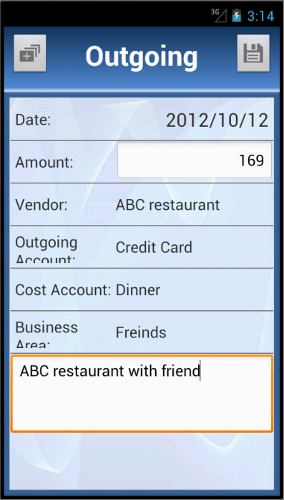
Outgoing Example
You had a dinner at ABC restaurant on Oct 12th 2012 with friends. You paid 169 for that with credit card.

Slide 6
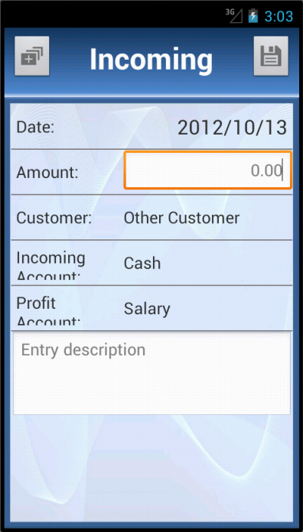
Incoming Entry
Date: date when financial event happens;
Amount: financial amount;
Customer: customer involved. For example, if you get salary from company DEF, you can enter company DEF here. However, before entering, you must add customer master data;
Incoming account: account to store the money;
Profit account: account that the incoming item belongs to;
Description: other information of the incoming.

Slide 7
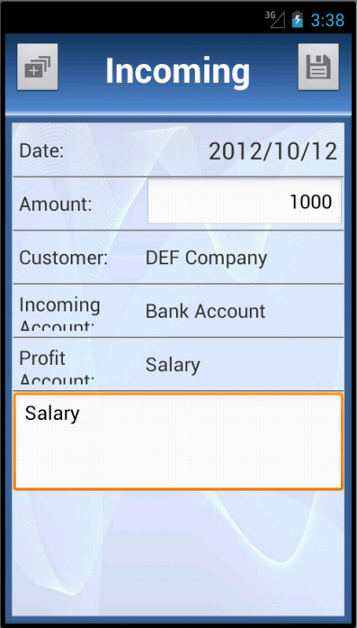
incoming Example
You got 1000 from DEF company on Oct 12th 2012 as salary.

Slide 8
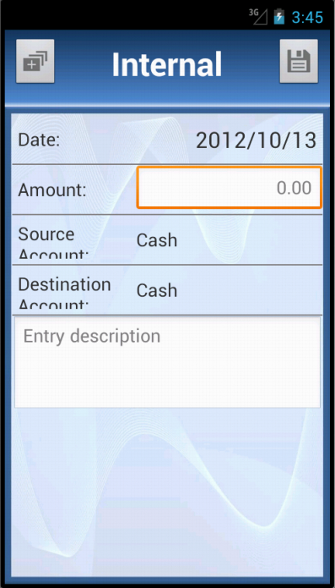
Internal transfer Entry
Date: date when financial event happens;
Amount: financial amount;
Source account: account where money transfers from;
Destination account: account where money transfers to;
Description: other information of the incoming.

Slide 9
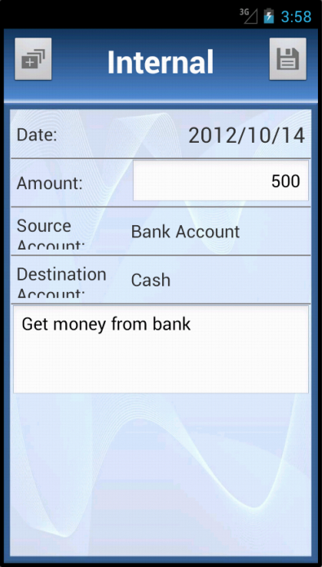
INTERNAL Transfer Example
You got 500 from bank on Oct 14th 2012.

Slide 10
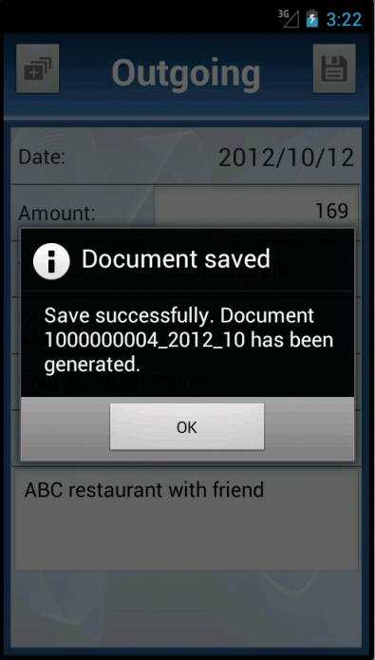
Entry Saving
Click ‘SAVE’ button to save the record and a notification dialog will pop-up.

Slide 11
Fast Entry
The application supports the functionality to create entry templates. Then outgoing entry, incoming entry or internal transfer entry can be created with an entry template.
For example, you go to work every work days. So you will create outgoing entry with same vendor, outgoing account, cost account and business area, description and even amount.
With entry templates, you can create template for “Traffic cost on work”. And every day, you only need to open the template and save, which is only two steps.

Slide 12
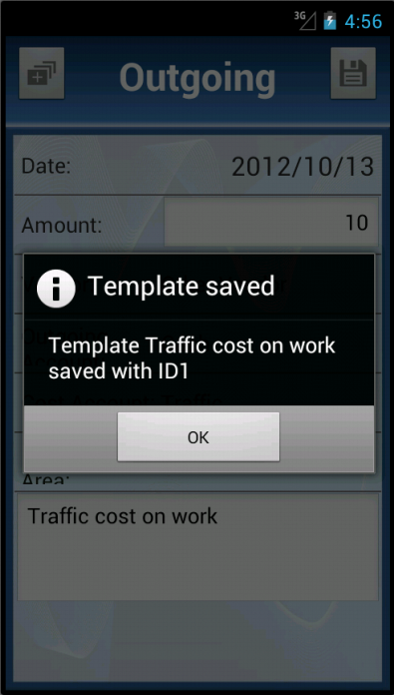
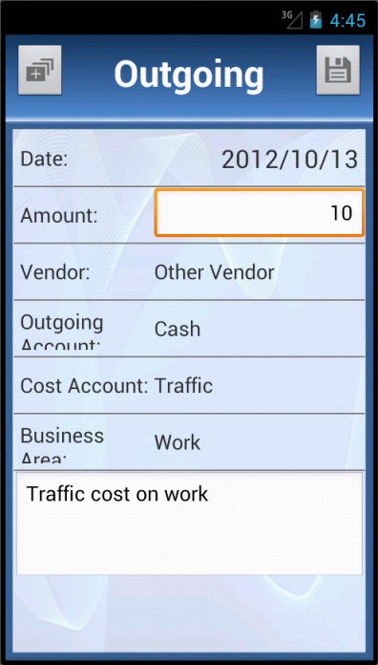
Create new template
For example, if you would enter “Traffic cost on work” record every, you can create template. You can set vendor as “Other vendor”, outgoing account as “Cash”, cost account as “Traffic” and business area as “Work”. Description is mandatory for template creation, which will be the name of template. Amount is option, you can leave it empty.
Click button to create template.

Slide 13
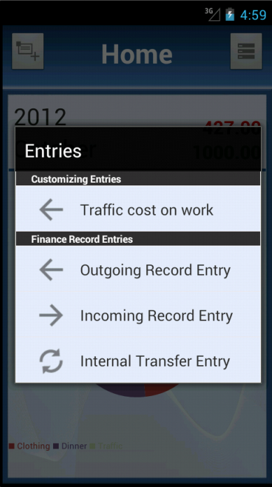
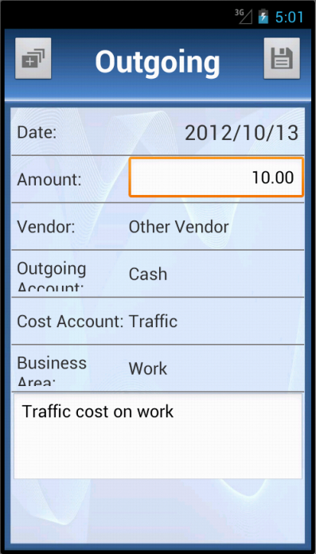
Enter with template
Click the template to create entry with template. Then enter the record as normal entry.

Slide 14
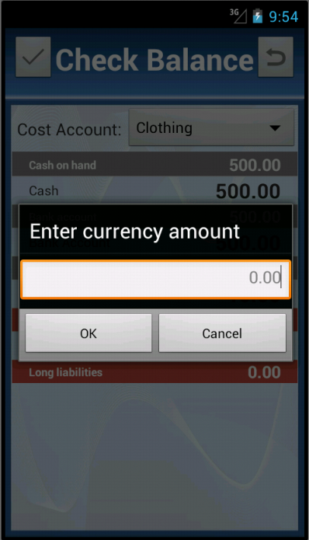
Check Balance
Why use balance check?
In ideal situation, the balance of account recorded in system should exactly equal to that in real world. In fact, it is not the truth. It is probably to forget to record some financial event or loss some money. So balance check is very important to keep the amount match from system to real world.
How to use balance check?
Click home->menu->check accounts balance
In “Check Balance” screen, click accounts to enter the current balances if they are different.
Select a cost account.
Click check to save.

Slide 15
Close Ledger
Ledgers are isolated by month, which can contain the financial event. Open ledger is a special ledger where financial event can be created and modified. All data in closed ledger is solid. And only one open ledger in the system at a time.
In the end of a month, user should check the balance and etc., then close the month ledger. System will close current month ledger to solidify the data and create a new ledger for next month.

Slide 16
Outlines
Daily record entry
Reports
Family-Accounting Settings
Advanced functionality

Slide 17
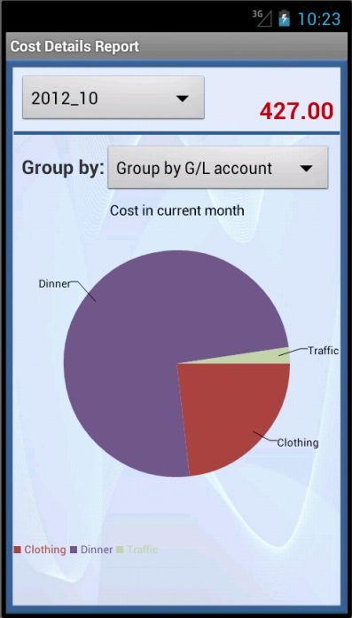
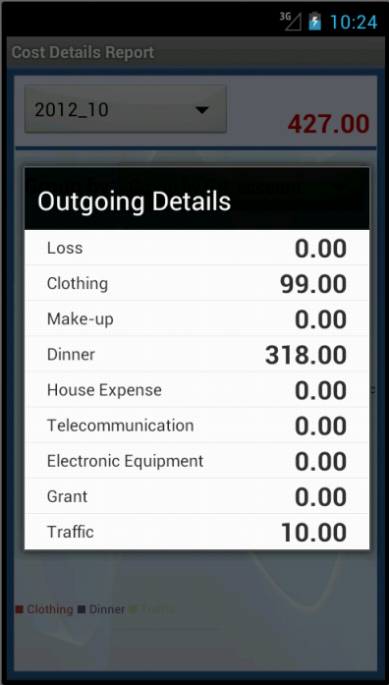
OUTGOING details report

Slide 18
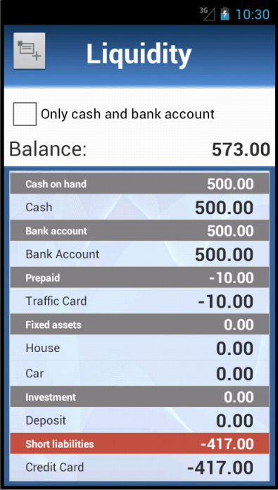
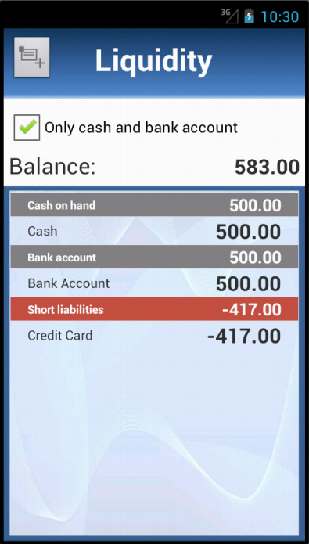
Liquidity report

Slide 19
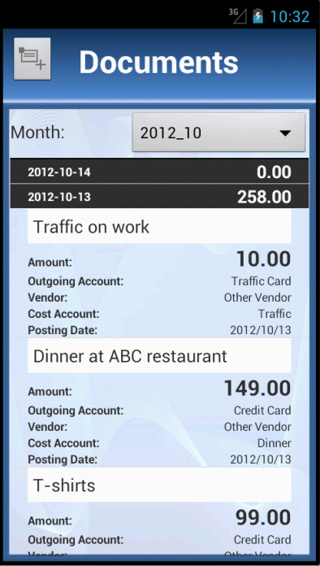
All Documents

Slide 20
Outlines
Daily record entry
Reports
Family-Accounting Settings
Advanced functionality

Slide 21
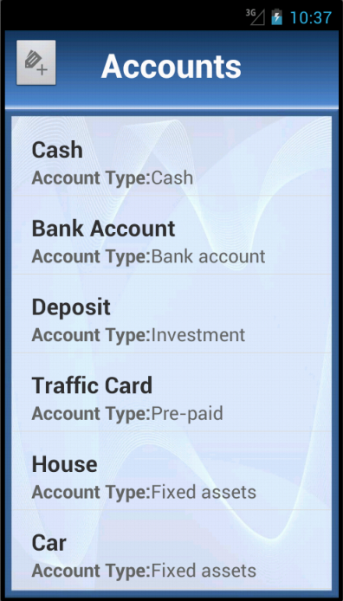
Accounts Setting
Account Type
Cash: cash on hands
Bank account: bank saving accounts…
Investment: deposit, stock investment…
Pre-paid: traffic card…
Fixed asset: electronic equipment, car, house…
Short liabilities: credit card…

Slide 22
settings
Cost accounts setting;
Revenue accounts Setting;
Vendor Setting;
Customer Setting;
Area Setting: priority is the critical level of the area.

Slide 23
Outlines
Daily record entry
Reports
Family-Accounting Settings
Advanced functionality

